Slide 1
C++ Programming
Jerry Lebowitz

Slide 2
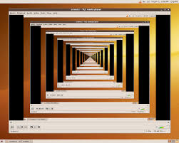
Topics
Recursion

Slide 3
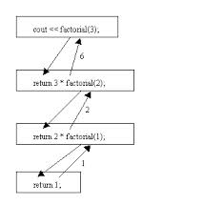
Recursion (1)
Recursion is when a function calls itself or calls a function which in turn calls the originating function
A recursive solution to a problem must be written carefully
Need to avoid making an infinite sequence of function calls (infinite recursion)
Each recursive algorithm must have at least one base case, as well as a general (recursive) case
One must supply an exit routine (make sure that code is not an endless loop)

Slide 4
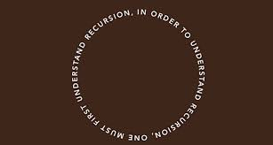
Recursion (2)
Recursion is used since some problems are easier to code using this technique
Recursive programs tend to use alot of memory
Every recursive program can be rewritten with an iteration replacing the recursion
Conversely, every iteration can be written with recursion replacing iteration

Slide 5
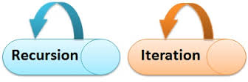
General Format for Many Recursive Functions
if (some easily-solved condition) // base case
solution statement
else // general case
recursive function call

Slide 6
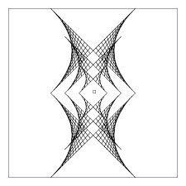
When a Function is called ... (1)
When any function is called the run-time stack is used
On this stack is placed an activation frame for each function call
The activation frame contains the return address for this function call, and also the parameters, and local variables, and space for the function’s return value, if non-void
These frames are put on a stack
They are destroyed in reverse order in which they are created
This stack is a last in/first out (LIFO)
There is a limit on the size of the stack

Slide 7
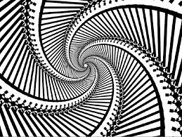
When a Function is called ... (2)
If the operating system runs out of stack space, there may be a stack overflow error or the computer may simply stop responding until a reboot
Stacks overflows are usually caused by infinite recursion
The activation frame for a particular function call is popped off the run-time stack when the final closing brace in the function code is reached, or when a return statement is reached in the function code
At this time the function’s return value, if non-void, is brought back to the calling block return address for use there

Slide 8
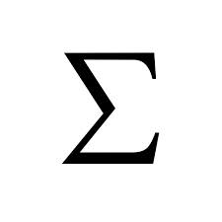
Summation
Writing a Recursive Function to Find the Sum of the Numbers from 1 to n called Summation
The sum of the numbers from 1 to n, that is,
1 + 2 + . . . + n can be written as
n + the sum of the numbers from 1 to (n - 1),
that is, n + 1 + 2 + . . . + (n-1)
or n + Summation(n - 1)

Slide 9
Summation(4) Trace of Call
Returns 4 + Summation(3) = 4 + 6 = 10
Call 1:
Summation(4)
Returns 3 + Summation(2) = 3 + 3 = 6
Call 2:
Summation(3)
Returns 2 + Summation(1)
= 2 + 1 = 3 Call 3:
Summation(2)
n==1
Returns 1
Call 4:
(See example recur1.cpp) Summation(1)
n
4
n
3
n
2
n
1

Slide 10

Factorial
Writing a Recursive Function to Find n Factorial
The function call Factorial(4) should have value 24, because that is 4 * 3 * 2 * 1 .
The value of Factorial(n) can be written as
n * the product of the numbers from (n - 1) to 1,
that is,
n * (n - 1) * . . . * 1
or, n * Factorial(n - 1)
See example recur2.cpp

Slide 11
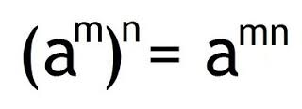
Other Examples Where Recursion Comes Naturally
2⁰ = 1 and 2⁵ = 2 * 2⁴
In general,
x⁰ = 1 and x^{n} = x * x^{n-1}
for integer x, and integer n > 0.
Here we are defining x^{n} recursively, in terms of x^{n-1}
See examples: recur3.cpp through recur4.cpp

Slide 12
PrintStars(3) Trace of Call
Call 1:
PrintStars(3)
* is printed
Call 2:
PrintStars(2)
* is printed
Call 3:
PrintStars(1)
* is printed
Call 4:
(See example recur5.cpp)
Do nothing
n
3
n
2
n
1
PrintStars(0)
n
0

Slide 13
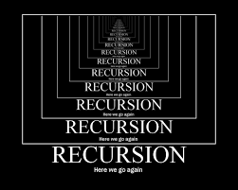
Writing other Recursive Functions
See examples: recur6.cpp and recur8.cpp

